Slide 1
Monthly Stakeholder Update Utilities Master Plan
March 28, 2023

Slide 2
STATUS
Status
Current Tasks
Upcoming Tasks
Schedule
Action Items
Phase 1: Assess existing utility systems to meet current levels of services
Engage utilities to capture and compile existing data
Field investigate critical features and attributes
Evaluate risk for current operations
Identify operational/maintenance/capital options
Existing conditions report for review

Slide 3
PREVIOUS ACTION ITEMS
Status
Current Tasks
Upcoming Tasks
Schedule
Action Items
Ongoing field investigation and data collection
Website content updated – dynamic site
BOV Subcommittee UMP review
CAC committee update

Slide 4
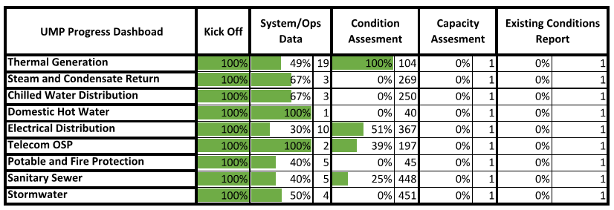
PROGRESS DASHBOARD

Slide 5
FIELD INVESTIGATION SCHEDULE
Status
Current Tasks
Upcoming Tasks
Schedule
Action Items

Slide 6
UPCOMING TASKS
Continue utility field investigations
Coordinate VT GIS app for Thermal Distribution systems
VT GIS continued support of utility field investigations
2047 Master Plan Review workshop scheduled for 5/2/23 at The Inn at Virginia Tech
Status
Current Tasks
Upcoming Tasks
Schedule
Action Items

Slide 7
ACTION ITEMS
Status
Current Tasks
Upcoming Tasks
Schedule
Action Items
UMP Monthly Stakeholder meeting on 4/25/2023
Field Investigations weekly stakeholder reminder
Schedule 30% Review Workshop to review Existing Conditions Report with stakeholders
Schedule CAC Workshops on Decarbonizing, Air Emissions, and Measures of Success

